Slide 1






Tuya WIFI Energy monitoring Circuit Breaker
Zhejiang Sichuang Power Technology Shares Co.,LTD
Zhejiang Science and Technology Manufacturer
Establish from 1998

Slide 2
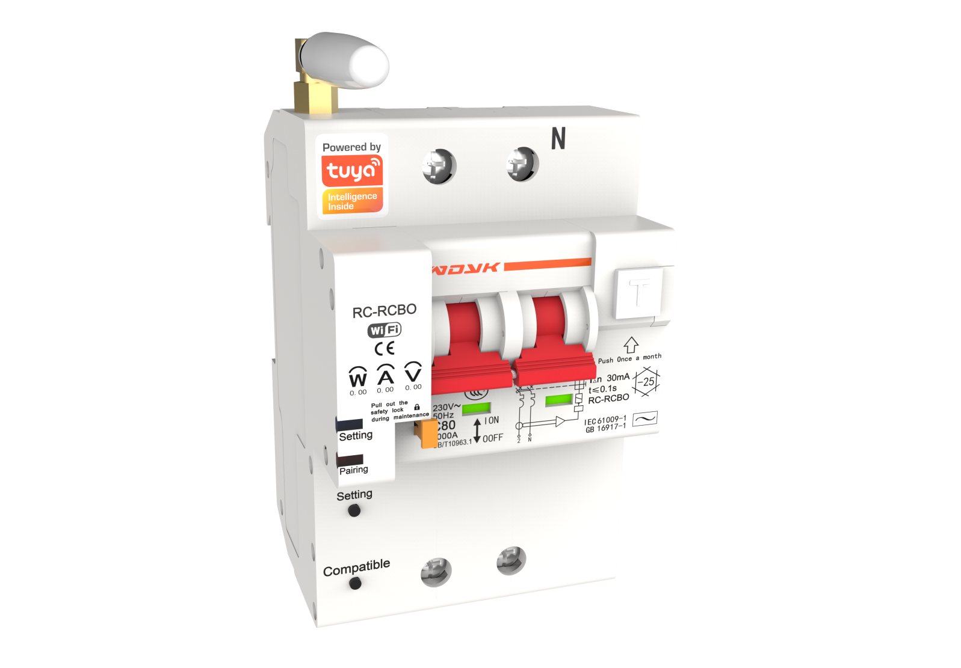

Zhejiang Sichuang Electric Power Technology Co., Ltd. was founded in 1998, focusing on the production of IoT circuit breakers, including WIFI circuit breakers, GPRS circuit breakers, RS485 circuit breakers, 4G circuit breakers, Cat1, NB, LAN circuit breakers, etc Connected products. With the leading technology, the digital age of the power distribution system is opened to make the power supply more reliable, more efficient and more convenient.
At present, the company once again launched a new generation of graffiti WIFI metering circuit breaker, which adopts triple leakage protection method to improve the product's failure resistance rate, which has great practical significance for the protection of personal and property safety. Tuya smart circuit breaker also has remote data monitoring, customers can easily view the real-time voltage, current and power information of the circuit. Provide various functions such as historical power data query, current threshold protection setting, voltage threshold protection setting, leakage threshold protection setting, mechanical lock protection, overdue tripping, remote closing and opening control, etc., to meet the application requirements of different requirements, and provide customers with Come to the diverse information experience of IoT technology.
1
Tuya Smart
Cloud Control Leak Protection

Slide 3


Feature
Three interlock protection
DC
The first ONE
Temperature and humidity control
Certification
2
Two-way security lock
APP remote control
Cat1
not easy bad
Ethernet
with power/no power
3C、CQC
DC energy monitoring
4G MCCB
4G、NB Card independent
Smart Circuit Breaker

Slide 4


01
Feature

Slide 5
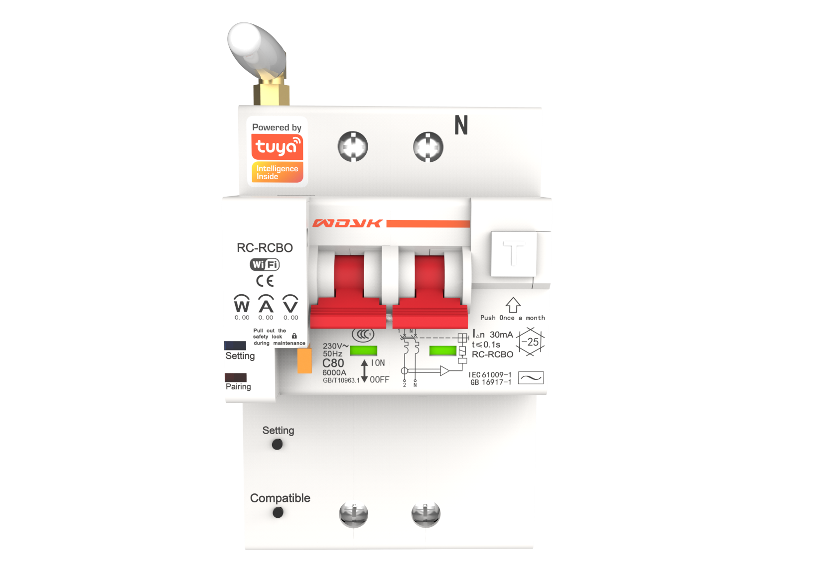
01
Electromagnetic trip protection
02
Spanned trip protection method
03
Threshold setting protection method
3
Not easy bad leakage protection function
Our leakage circuit breaker solves the two major pain points of the traditional leakage circuit breaker
●Need periodic manual testing----almost no one can do it
●Even if it does periodic testing----it has flaws
The leakage module of the product is designed as a triple-protection residual current action (leakage) protection switch. In the case of leakage module damage and failure, the product can still protect the action. It is designed to improve the reliability of electricity use and improve the product's own failure resistance rate. It has practical significance for improving personal and property safety.。
Through the transparent transmission of Internet of Things data, when a power leakage occurs, or when the module is damaged and fails, the data uploaded to the cloud will be abnormal or disappear. Then, through the interpretation of the data, the predetermined program can send an alarm to the user, timely maintenance and processing, and control the operation status of the product and the line as soon as possible.

Slide 6
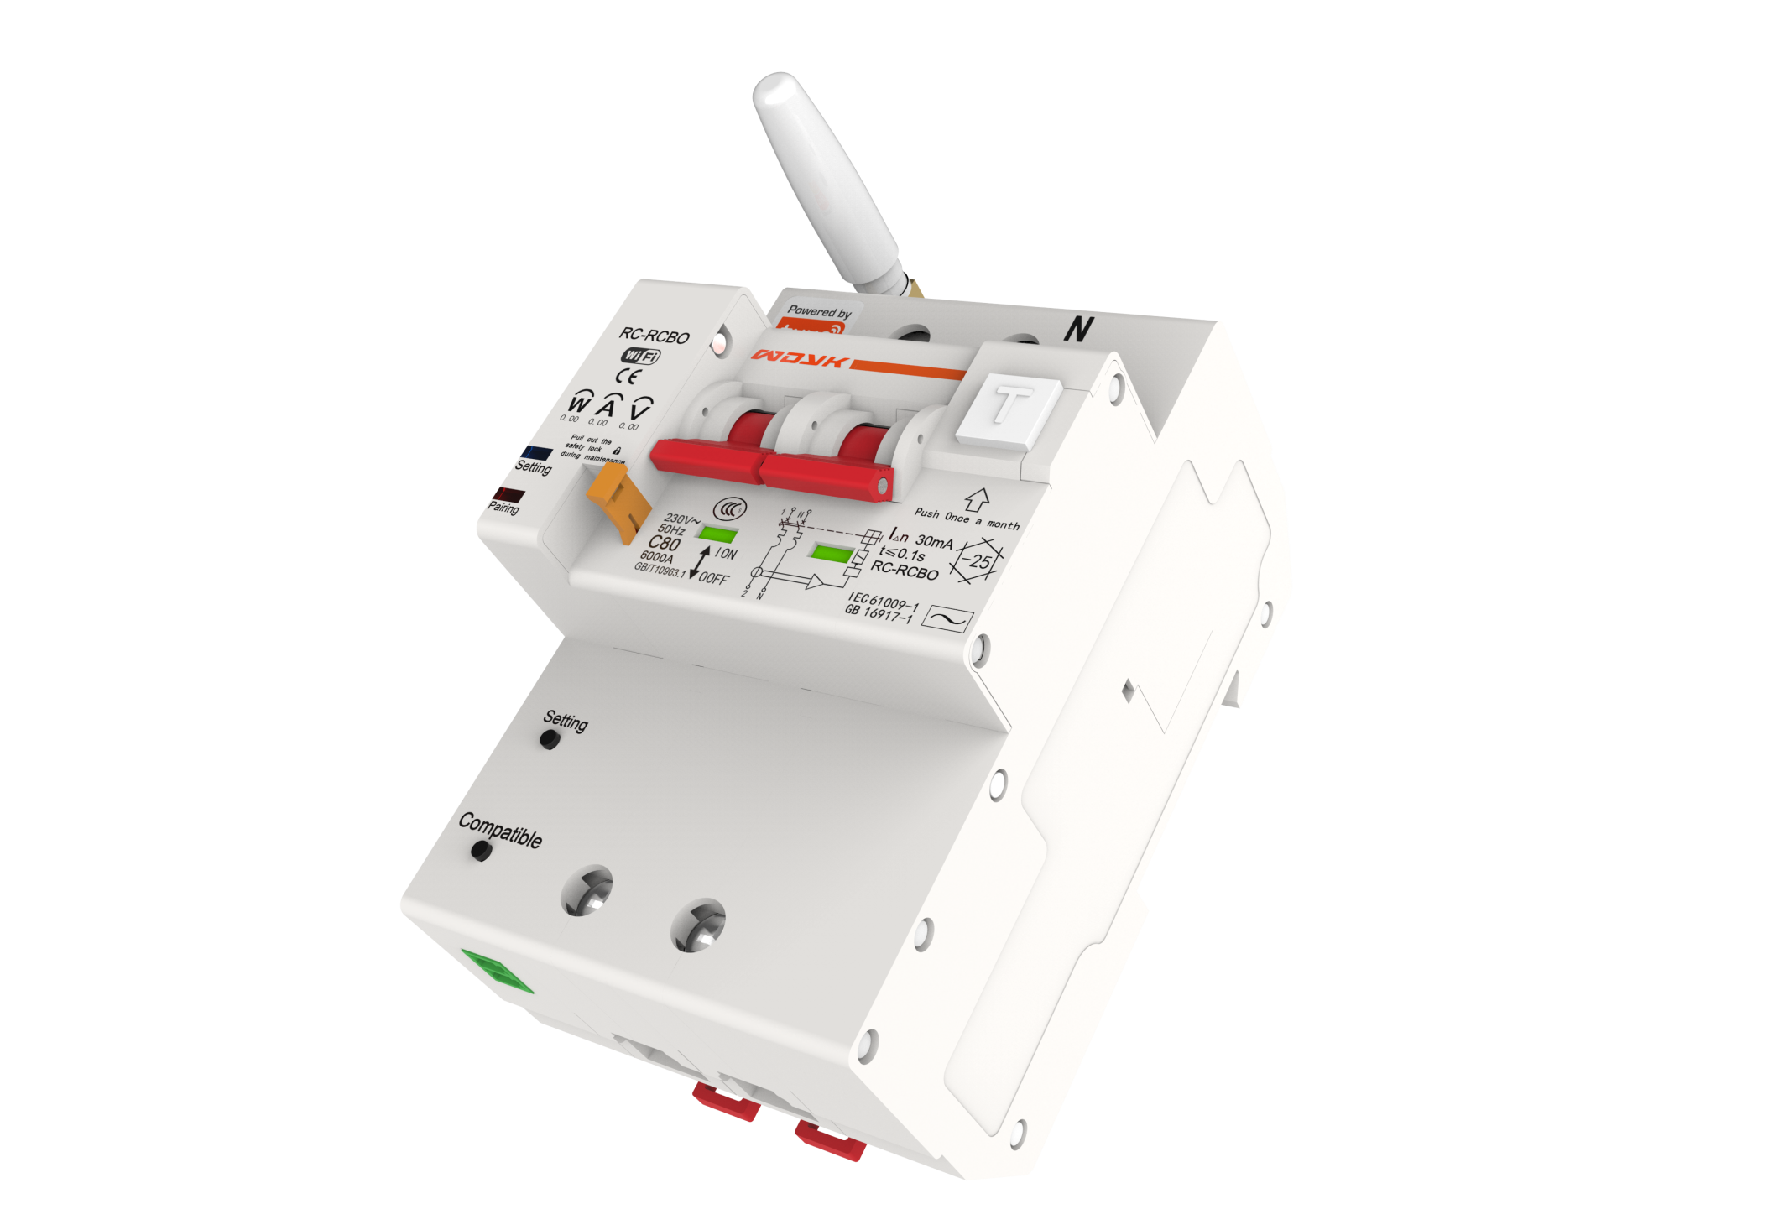
01
Remote control ON/OFF
02
Safety lock pull out, Breaker can not ON
03
Follow the steps to reset and unlock
4
Two-way anti-mis-opening----mechanical lock
During maintenance, the circuit breaker must always be kept in the closed position to ensure the safety of maintenance personnel. Because the remote control circuit breaker has multi-person operation authority and lacks an effective self-locking device, the remote control circuit breaker remains in a controlled state during the line maintenance process, which makes it possible for remote operators to misoperate the remote control circuit breaker. Endanger personal safety and cause property damage.
Therefore, our products are designed with mechanical locks that prevent accidental opening and operate during maintenance, effectively improving the safety of equipment maintenance. Avoid misuse.

Slide 7

02
Pairing

Slide 8
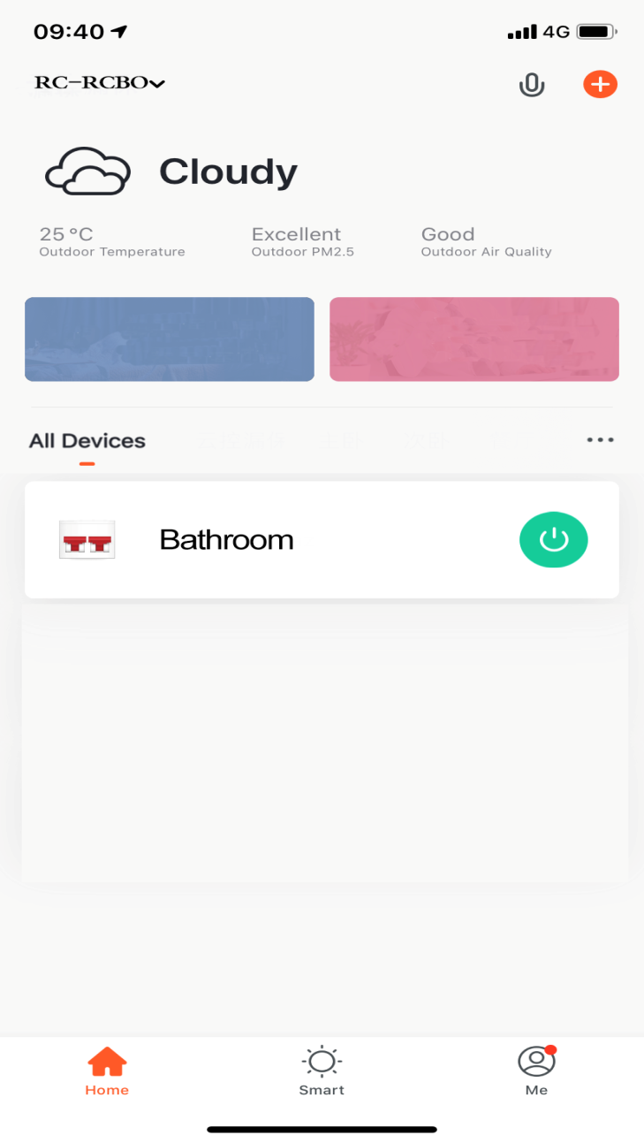
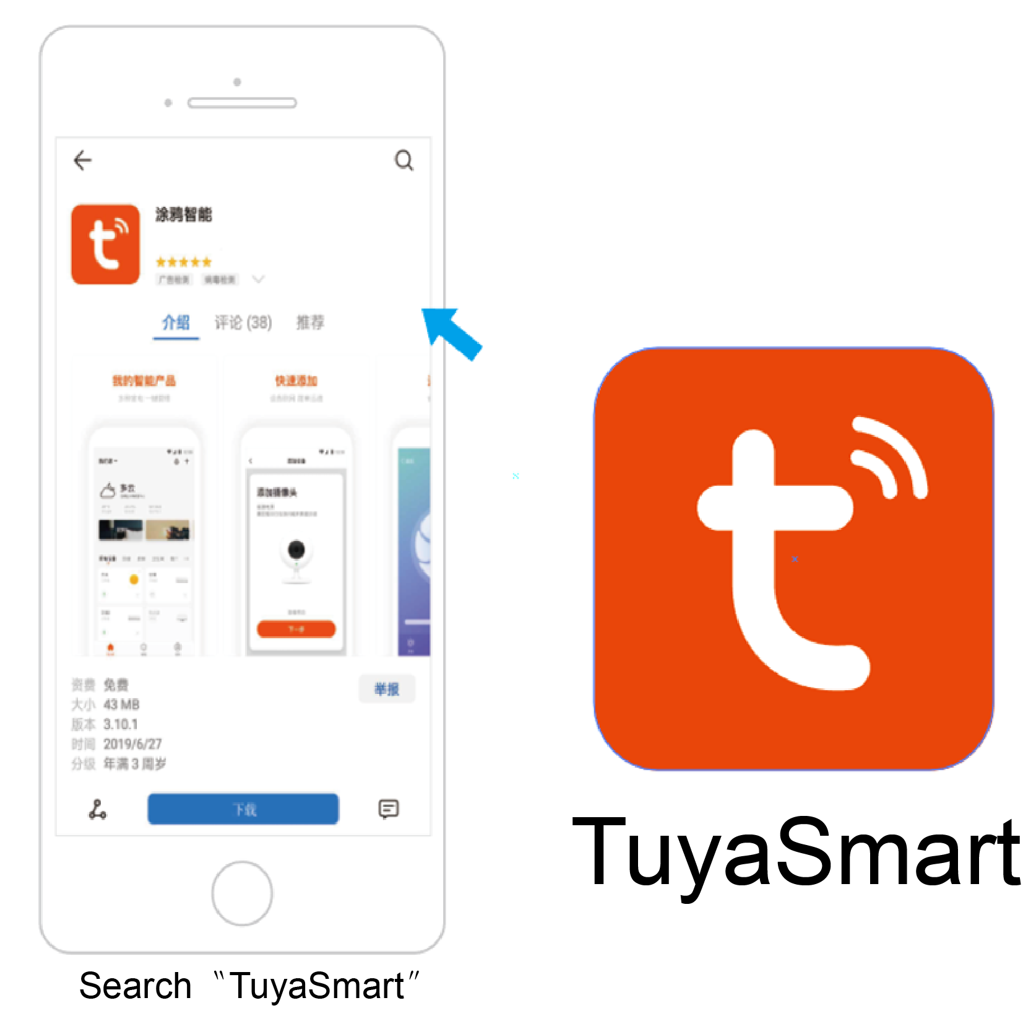
Download“Tuya”APP，Register an account and log in。
Enter the APP main page, click the red "+" button in the upper right corner。
01
02
5

Slide 9
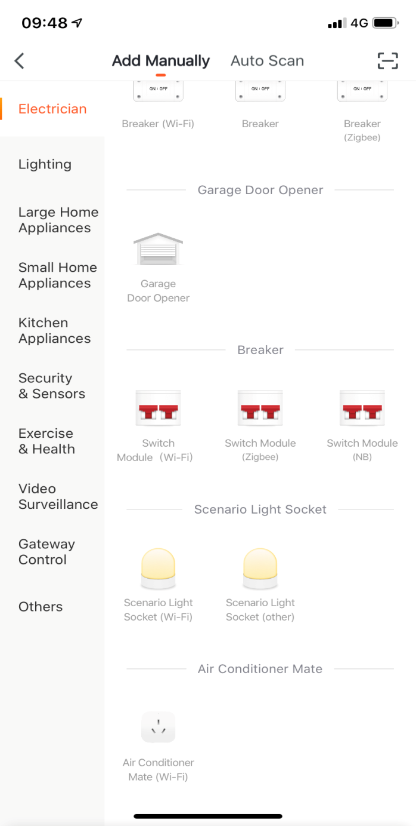
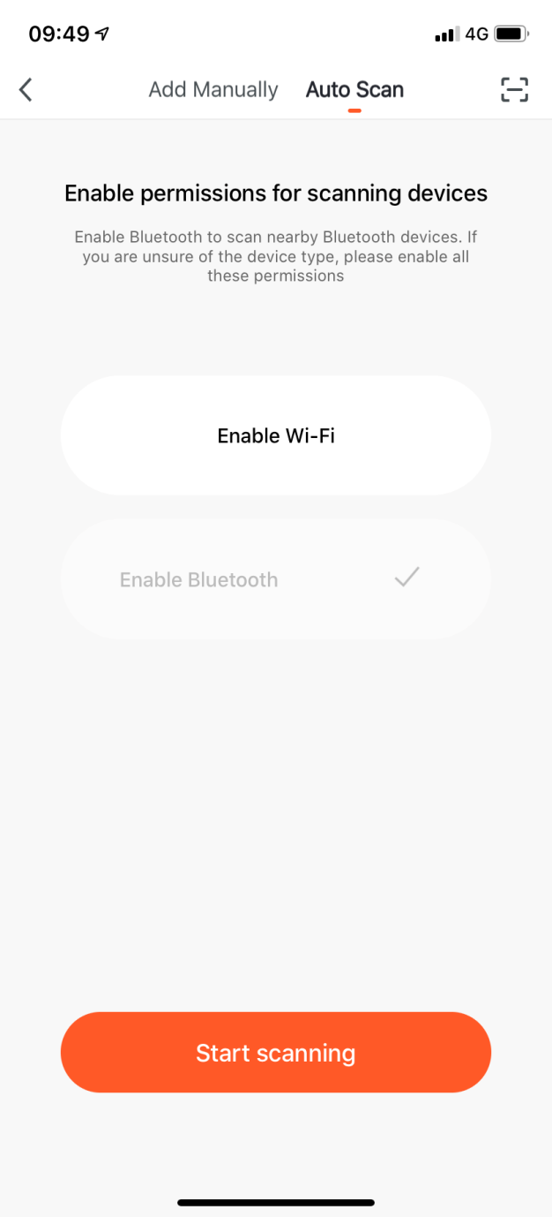
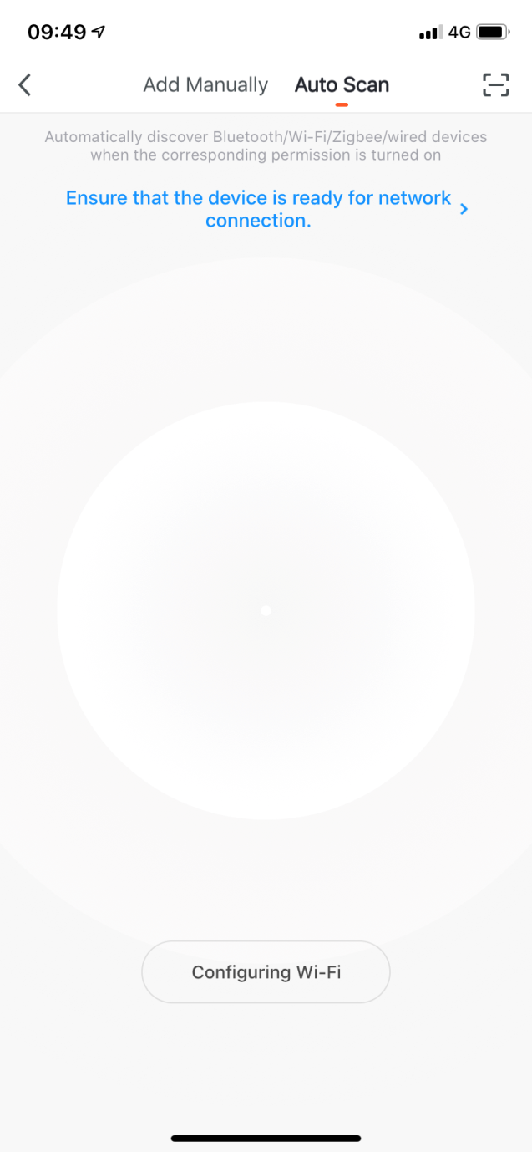
When Pairing,Select “Electrician”-Circuit Breaker(wifi)
Recommend that users select "Auto Discovery" to pair, this function can achieve multiple simultaneous pairing。
03
6

Slide 10
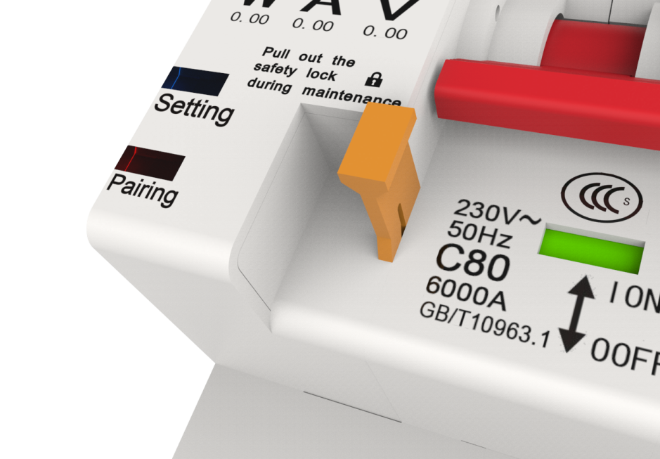
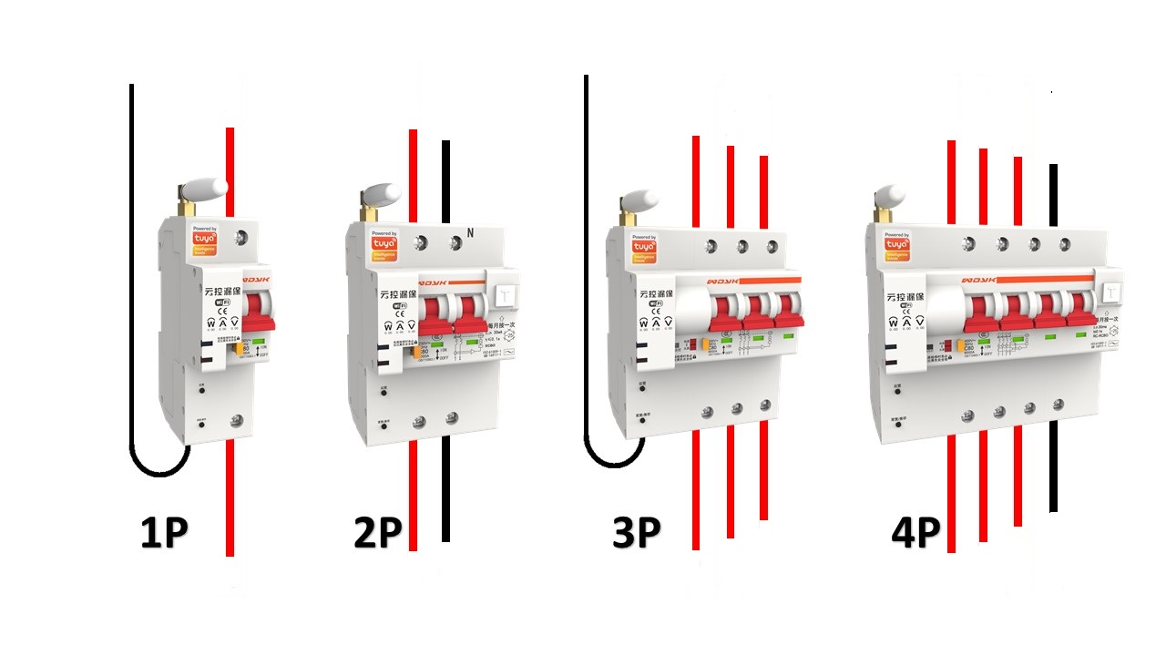
Wait for about 5 seconds, the pairing indicator becomes quick flashing。
Connect Power, Upper Input,Under Load
05
04
N
N
N
N
7

Slide 11
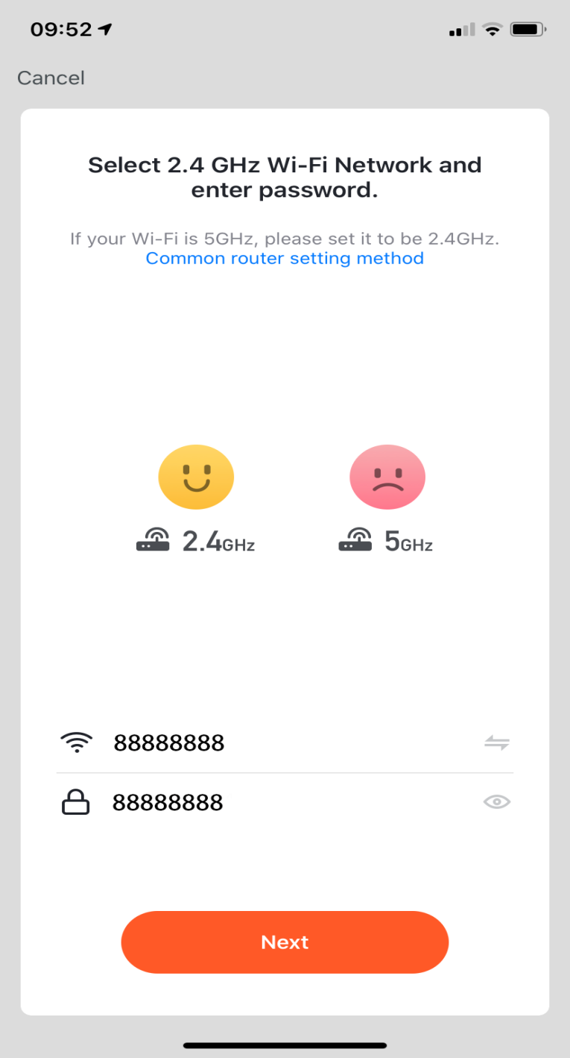
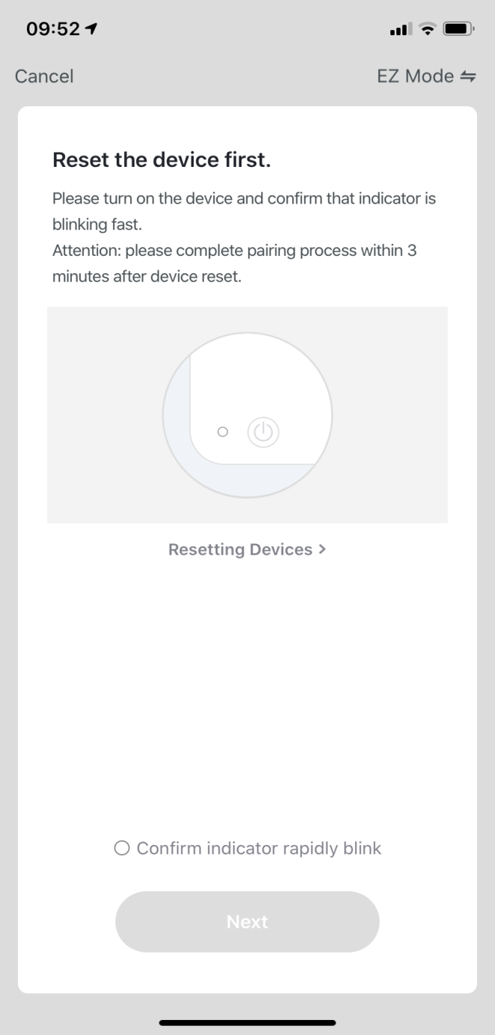
06
Enter the WIFI name and password.
Make sure the indicator is quick flash, press “next”button
07
8

Slide 12
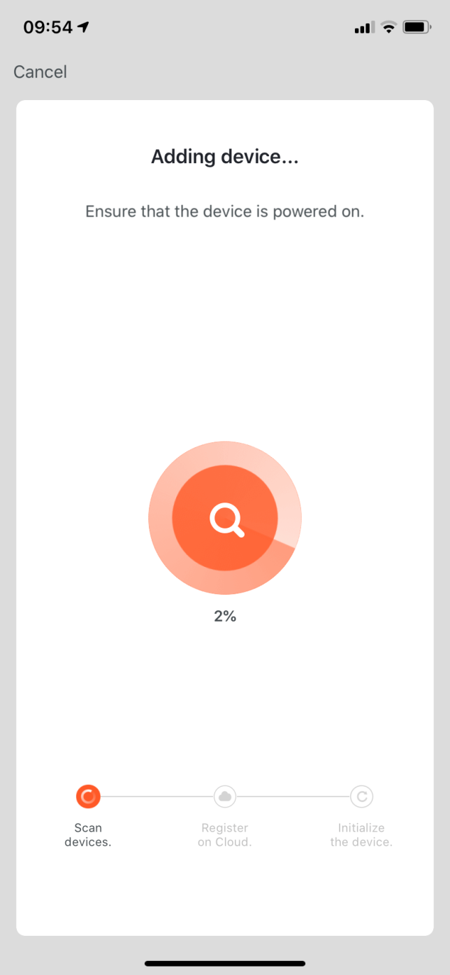

08
Waiting for the device to be added.
09
Pair successfully
9

Slide 13

Troubleshooting
3

Slide 14
01
Pair indicator light off
●Pair light off,Press “SET”button for 1s，indicator light change into Purple，press compatiable button for 3s，release and wait for 15s，View whether the pairing light flashes quickly
●Pair light off,Check whether the router WIFI signal is normal
●Pair light off,Check if the white antenna is installed,
●SET light off，check input and outpurt，only suport upper input.
●SET light off，Check if the input has voltage
●SET light off, Check whether the neutral wire is connected to the neutral wire terminal of the power supply terminal as required, and cannot be grounded
●SET light off，Turn off input power, reconnect, then try to see if the indicator light will come on
10
02
Offline
●Check if the WIFI router is working properly
●Check whether the WIFI and mobile phone are connected to the external network
●Check if the phone is equipped with anti-virus software and other software that restricts access to specific apps
●Check if the input has power and whether the pairing light flashes
●If there is no abnormality, you can reset the device: press the setting button once, after seeing the setting indicator light purple, long press the compatible button for more than 3 seconds, release the button and wait about 15 seconds。

Slide 15
03
Pair failure
●Check if the WIFI router is too far away from the circuit breaker
●Check whether the router name and password entered by the APP are correct. The name and password must not contain Chinese or special characters
●Check the pairing indicator, whether it has entered the fast pairing mode or compatible pairing mode; when the display is evenly flashing (0.5 seconds / flash once), it means that the product is in fast mode; when the display is evenly flashing (3 seconds / flash ), Indicating that the product is in compatibility mode.
●Check if there are multiple WIFI routers with strong strength in the environment, you should temporarily turn off unnecessary routers for pairing
●Check if the WIFI router is 5G or 2.4G. This product supports 2.4G, not 5G.
●Check if there are too many devices connected to the WIFI router, the router has an upper limit on the number of access devices
●Check whether the mobile phone is connected to the WIFI network. When pairing, the mobile phone and this product must be connected to the same WiFi router
●When there is no abnormality in other checks, you can try the pairing in compatibility mode.
11

Slide 16
04
Can not remote control
●Check if the product is offline
●Check whether the WIFI connection to the external network is normal
View whether there is an alarm prompt in the upper right corner of the APP. If yes, please click to view and eliminate the corresponding fault.
●Check whether the mechanical lock of the product is pulled up, and the mechanical lock needs to be reset before the line is overhauled before it can be opened normally
●Check if the child lock function is turned on in the setting interface of the APP. You need to release the child lock function before it can be opened normally.
●Check whether the threshold protection of current, voltage, residual current and temperature is turned on, the product may exceed the limit，Protectively close. After closing the above functions, try to open remotely.
●Check whether the APP has enabled the arrearage trip function, there is arrearage trip setting in the setting interface, charge the electricity or check whether there is residual current protection (leakage protection) trip, if the line has leakage, please eliminate the line problem
12
05
Can not manual open
●Check if the product mechanical lock is pulled up
●Don't worry when the power is interrupted during the opening process or the superior leakage protection switch trips during the opening process and the switch handle is stuck. Please don't worry, the product will reset after power on.

Slide 17
06
Compatiable mode pair(Use in special cases)
●Android：
Power on the product → wait for about 5 seconds, see the flashing state of the pairing indicator → press the pairing button once (the button on the lower left side of the product) through the tool → wait for about 15 seconds → the device pairing light becomes even and slow flashing (3 seconds / flash Once) → Enter the APP and click the “+” button on the upper right, → select the circuit breaker (WIFI) in the circuit breaker category in the electrician column → enter the WIFI name and password, click Next → select slow flash (3 seconds / flash once) → Follow the prompts to connect to the hot spot → Wait for the pairing process → Pairing is successful.
● ISO：
Power on the product → wait for about 5 seconds, see the flashing state of the pairing indicator → press the pairing button once (the button on the lower left side of the product) through the tool → wait for about 15 seconds → the device pairing light becomes even and slow flashing (3 seconds / flashing) Once) → enter the APP and click the “+” button on the upper right, → select the circuit breaker (WIFI) in the circuit breaker category in the electrician column → enter the WIFI name and password, click Next → click “hotspot distribution network (compatible mode ) ”→ The confirmation light flashes slowly, the next step → open the WIFI setting interface of the mobile phone as prompted → select the hotspot at the beginning of SmartLife _ **** → return to the Tuya Smart APP after successful connection → click next step → wait for the pairing process → pairing success
13

Slide 18
07
How to set RS485
●Use a USB to RS485 converter to connect the device to the USB port of the computer → power on the product → press the setting button once with a tool (or paperclip) → the setting light turns purple at this time → the software can be modified by the test software or user data frame at this time Device address information threshold setting value, etc. → After setting modification is completed → Press the setting button once with the tool, or wait for 15 minutes → The device returns to normal working state.
14
08
How to delete device
●Enter the mobile phone doodle smart app → click the product to enter the large operation interface → click the button in the upper right corner to enter the device information to the bottom → click remove the device → unbind and clear the data.

Slide 19
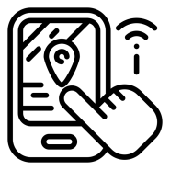
4
APP USE

Slide 20

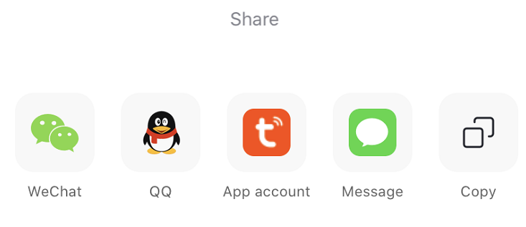
01
Button interface can be opened and closed
02
Share control
03
Group management equipment
15
APP button interface
In the APP button page, the added device is displayed, and it can be directly controlled to open and close. You can view the weather and temperature of the user's location. This page can also change some settings of device display mode or group characteristics, including display mode (list / square), device management, device group management.
The main page can control not only your own device, but also the devices shared by others. The shared devices must be shared before operation.
Share way：

Slide 21
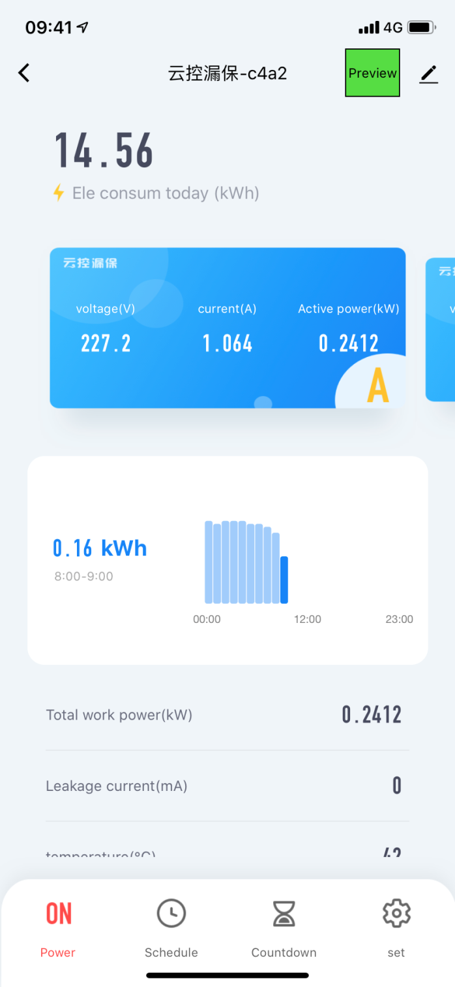
04
Main interface can ON and OFF
05
Timing , countdown control equipment
06
Can view real-time voltage, current, power and other information
16
APP main interface
On the main page of the APP, on / off control, timing control settings, and countdown control settings can be set for the device. And can directly view the current voltage, current, active power, and other information.
When you click the kilowatt-hour (kWh) display box, you will enter the power query interface and display historical power data.

Slide 22
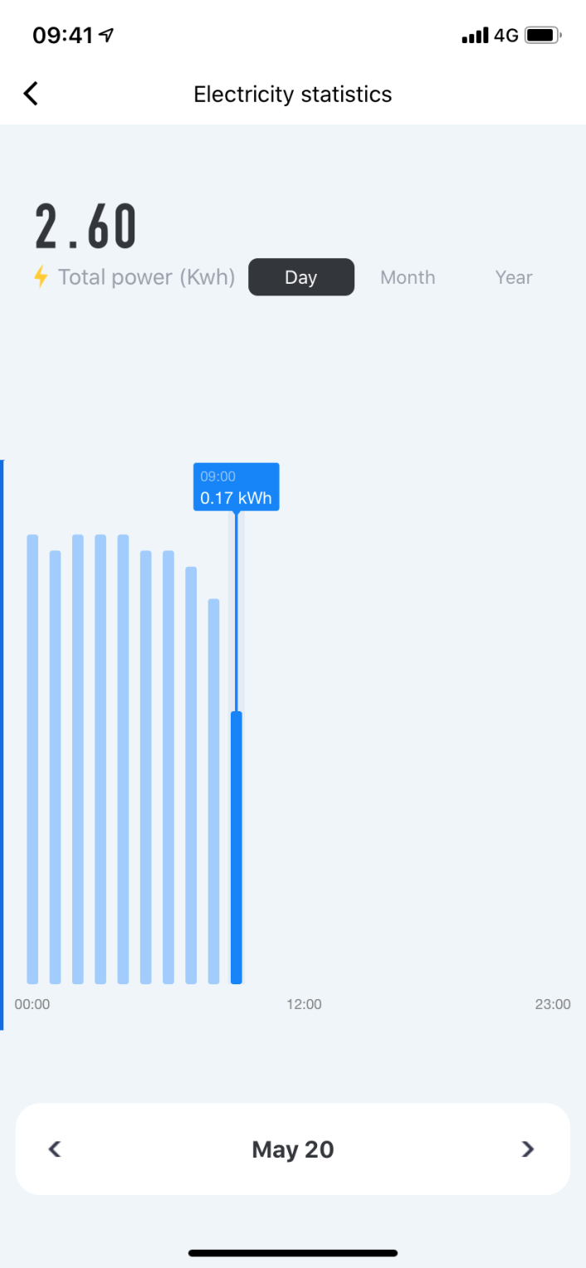
07
Can view the total accumulated power data
08
Can view day, month and year data
09
Long press the display bar, the specific data will be displayed
17
APP Power Inquiry Page
In the APP power query interface, you can view the total accumulated power data, you can view the power consumption data for a certain day, month, and year. Long press the data bar with your finger and the cumulative power consumption will be displayed at the top.
If you want to reset or reset the data, you can set the power reset operation through the main page, the operation will be introduced separately.
(Note: After the network is disconnected, the product will still measure the power consumption,)

Slide 23
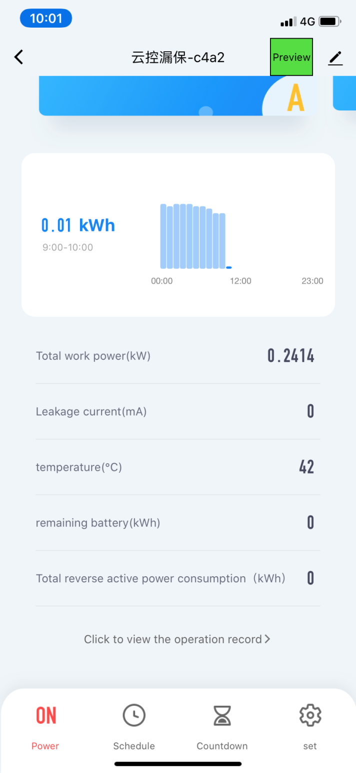
10
The main interface pulls down, there is the device temperature, remaining power, total reverse active power consumption。
18
APP Home page
After pulling down on the main page of the APP, the data of device temperature, remaining power, and total reverse active power can be displayed.
At the bottom right of the interface, there is a setting button. After entering, it will be the setting interface, which can set multiple protection values.

Slide 24
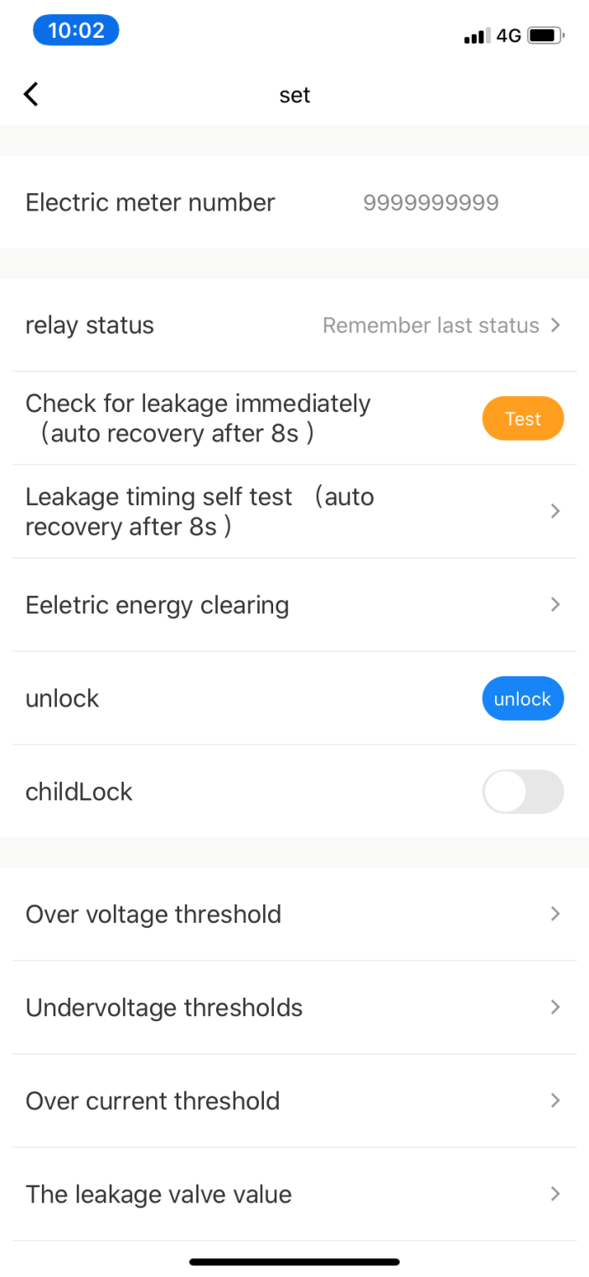
11
Power-on state setting
12
Residual current test, residual current periodic test settings
19
13
Energy clearance
APP SET interface
In the APP setting page, there are multiple circuit breaker settings, and thresholds can be set for multiple protection. Including power-on state setting, residual current test, residual current periodic test settings, energy clearance, etc.
Energy clearance is to reset all historical electricity consumption and restart calculation.

Slide 25
14
Residual current trip to unlock
15
Kid Lock
16
Overvoltage and undervoltage ,overcurrent threshold settings
20
APP SET interface
In the APP settings page, it also has residual current trip unlock, child lock setting, overvoltage threshold setting, undervoltage threshold setting, overcurrent threshold setting, residual current threshold setting, product temperature threshold setting, electricity price unit price simulation setting, simulated power charge Set up, arrears trip open setting.
When the child lock function is turned on, both the button interface and the main page of the APP will be locked and cannot be operated, preventing children or unrelated persons from triggering at will.

Slide 26
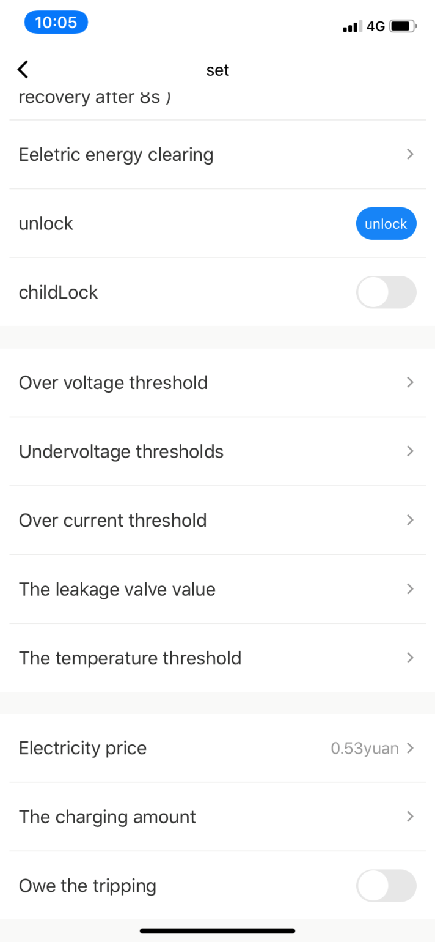
17
Residual current threshold setting
18
Product temperature threshold setting
19
Power recharge, arrears trip settings
21
APP SET interface
After pulling down on the APP settings page, it has settings such as power recharge and tripping of arrears. Here you can simulate the power recharge. After the arrears trip is turned on, the power used by the load will be deducted from the power recharge. After the deduction, the product will trip. Applicable to rental houses, shops, commercial streets and other places.

Slide 27

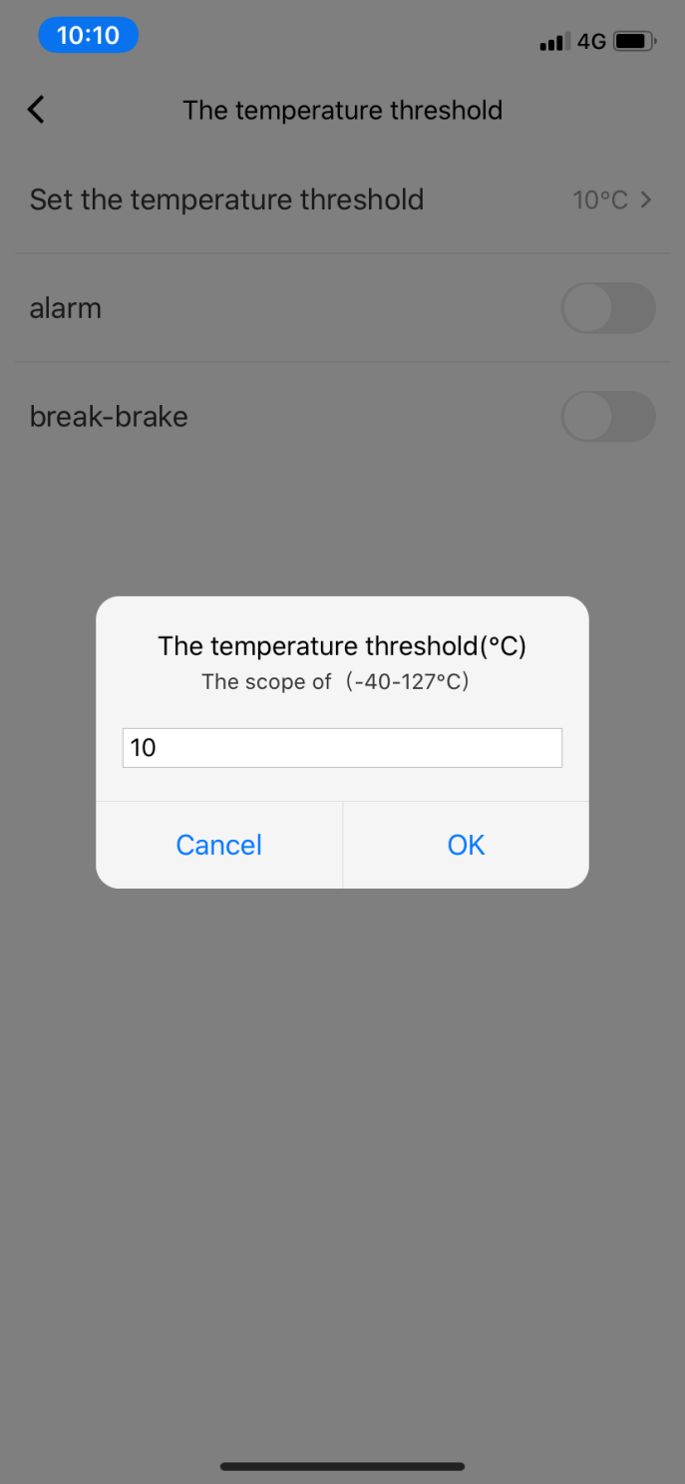
20
Product temperature threshold protection operation display
22
APP SET interface
In the APP setting page, there is protection for the temperature setting of the product. The interface is shown on the right. After clicking the temperature threshold, the APP interface will pop up the temperature threshold setting interface.
Including the temperature value set on the temperature threshold, including whether to open the alarm, including whether to open the ON/OFF protection.

Slide 28

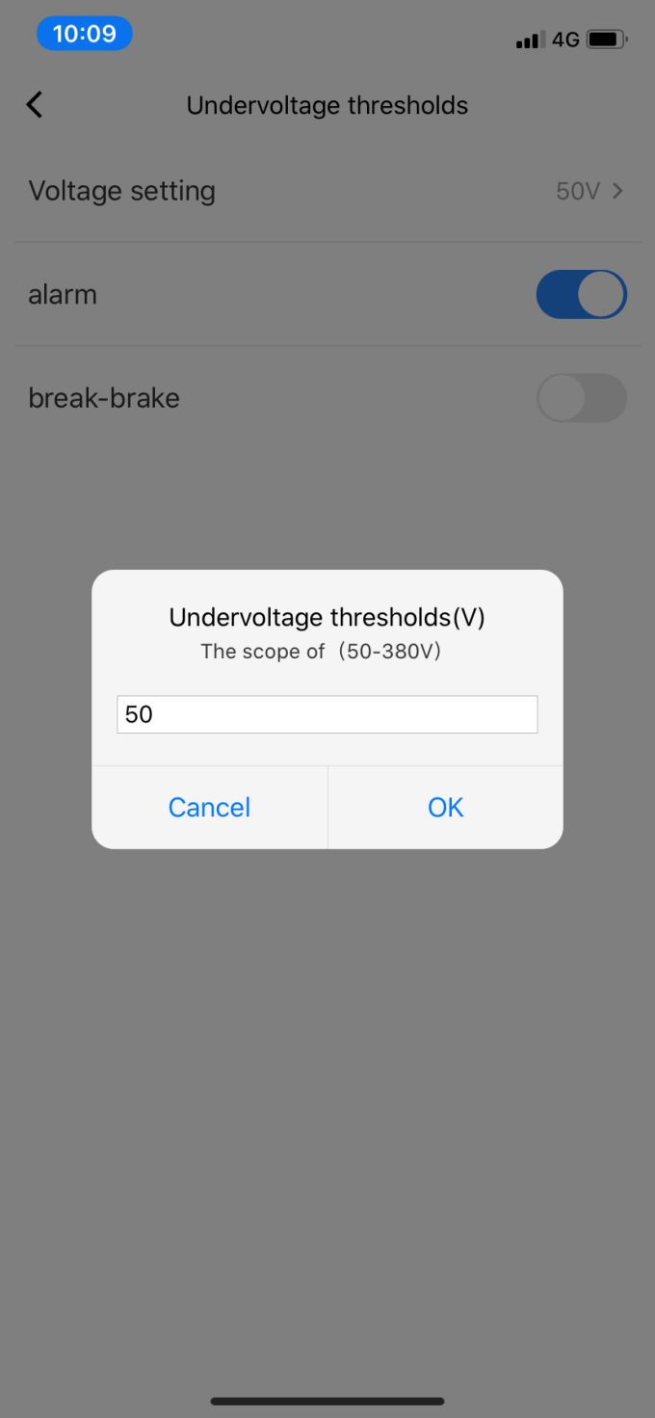
21
Undervoltage threshold operation display
23
APP SET interface
In the APP setting page, there is an interface option to protect the line voltage, and the undervoltage threshold setting page is shown on the right. After entering, including under voltage threshold can be set, including whether to open the alarm, including whether to open the opening protection.
After setting by the user, when the line undervoltage occurs, the circuit breaker will be tripped and protected to achieve the purpose of protecting the load.

Slide 29

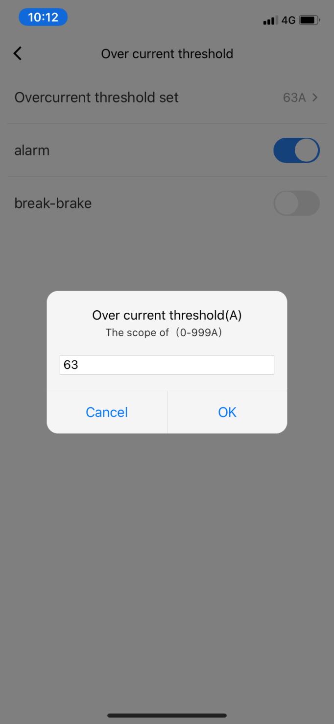
22
Overcurrent threshold operation display
24
APP SET interface
In the APP setting page, there is an interface option to protect the line current, and the overcurrent threshold setting page is shown on the right. After entering, including setting the current threshold, including whether to open the alarm, including whether to open the opening protection.
After setting by the user, when the line exceeds the set current value, the circuit breaker will be tripped and protected to achieve the purpose of protecting the load.

Slide 30

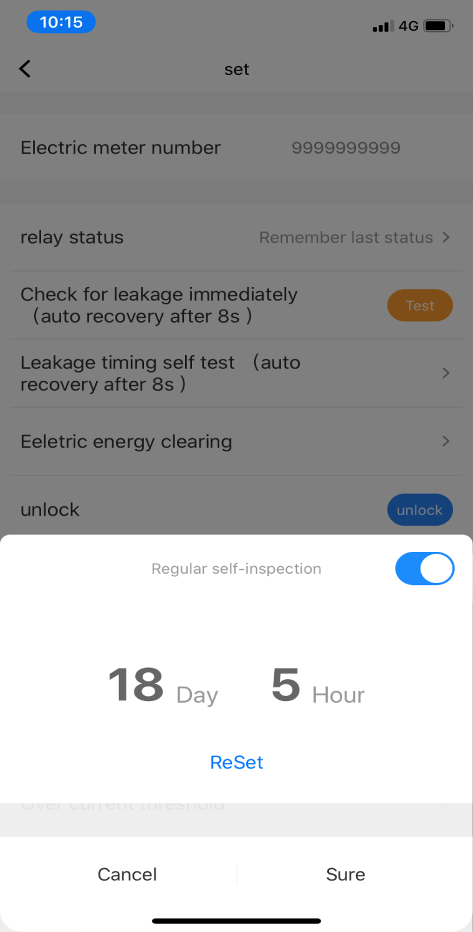
23
Residual current periodic test operation display
25
APP SET interface
In the APP setting page, it has the function of periodic testing of the residual current, which eliminates the trouble of manually operating the detection button every month, and also avoids the situation of missing detection.
The user sets the date and time of each month, and clicks on the regular test button; after the button is turned on, the test action will be triggered at this time every month, and after the action, wait for about 8 seconds to automatically overlap to achieve the test Restore power.

Slide 31
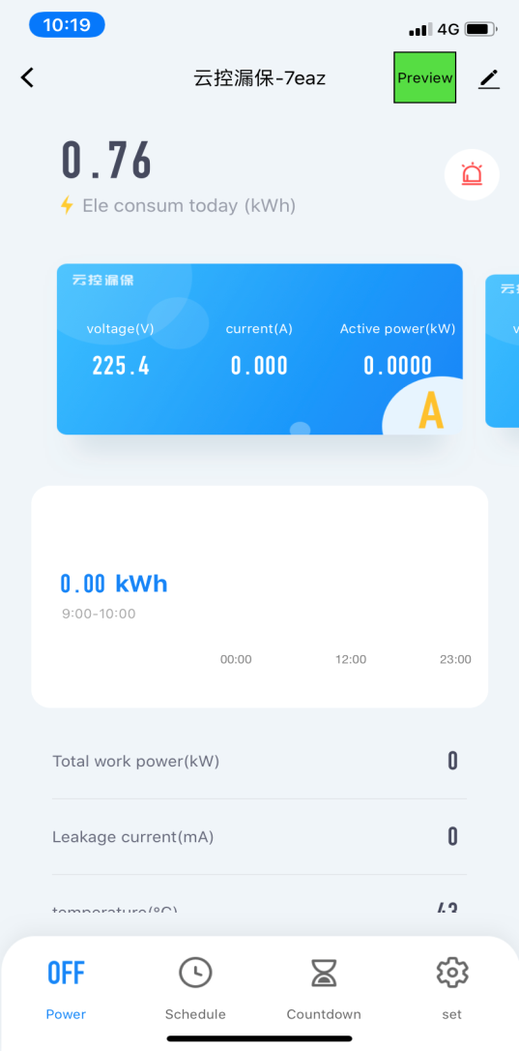
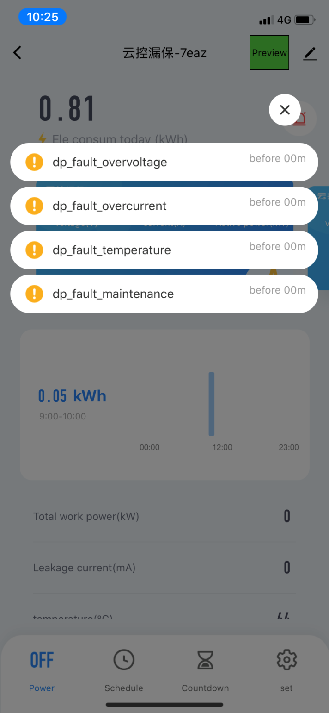
24
Fault alarm display
26
APP SET interface
On the main page of the APP settings, it has the function of reporting faults. In the setting page, there are multiple protection settings and threshold protection settings. When there is a situation in the line, an alarm notification will be pushed on the main page of the APP, such as overvoltage, overcurrent, and temperature. Overrun, residual current overrun, etc.

Slide 32
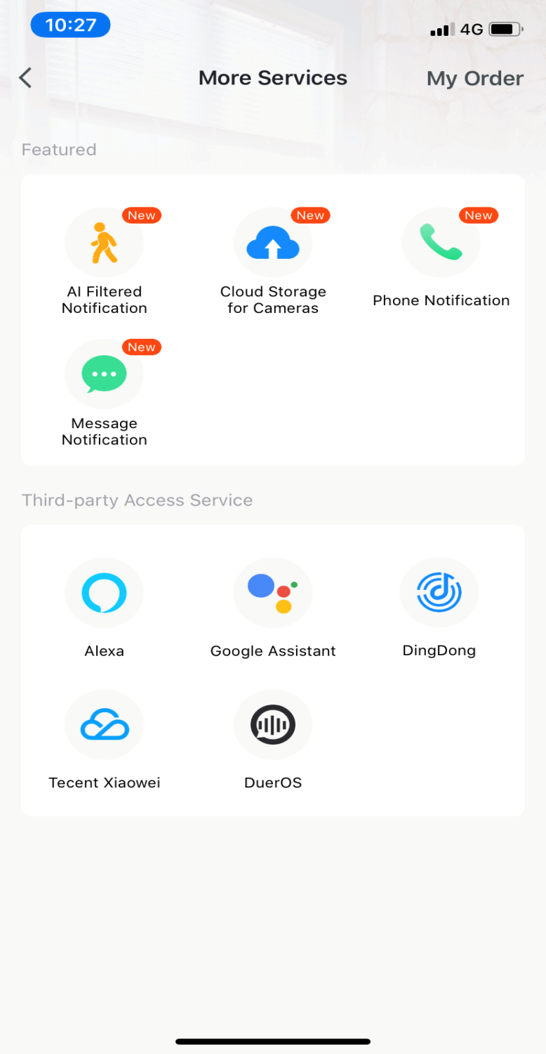
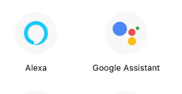
25
Phone, SMS notification（need pay）
APP supports third-party audio assistant
27
Through the APP button interface → "Me" on the lower right side → more services → phone notification, you can experience the service by prompting to open the service
Product status switch real-time telephone notification service.
Compatiable with Alexa and Google home assistant

Slide 33

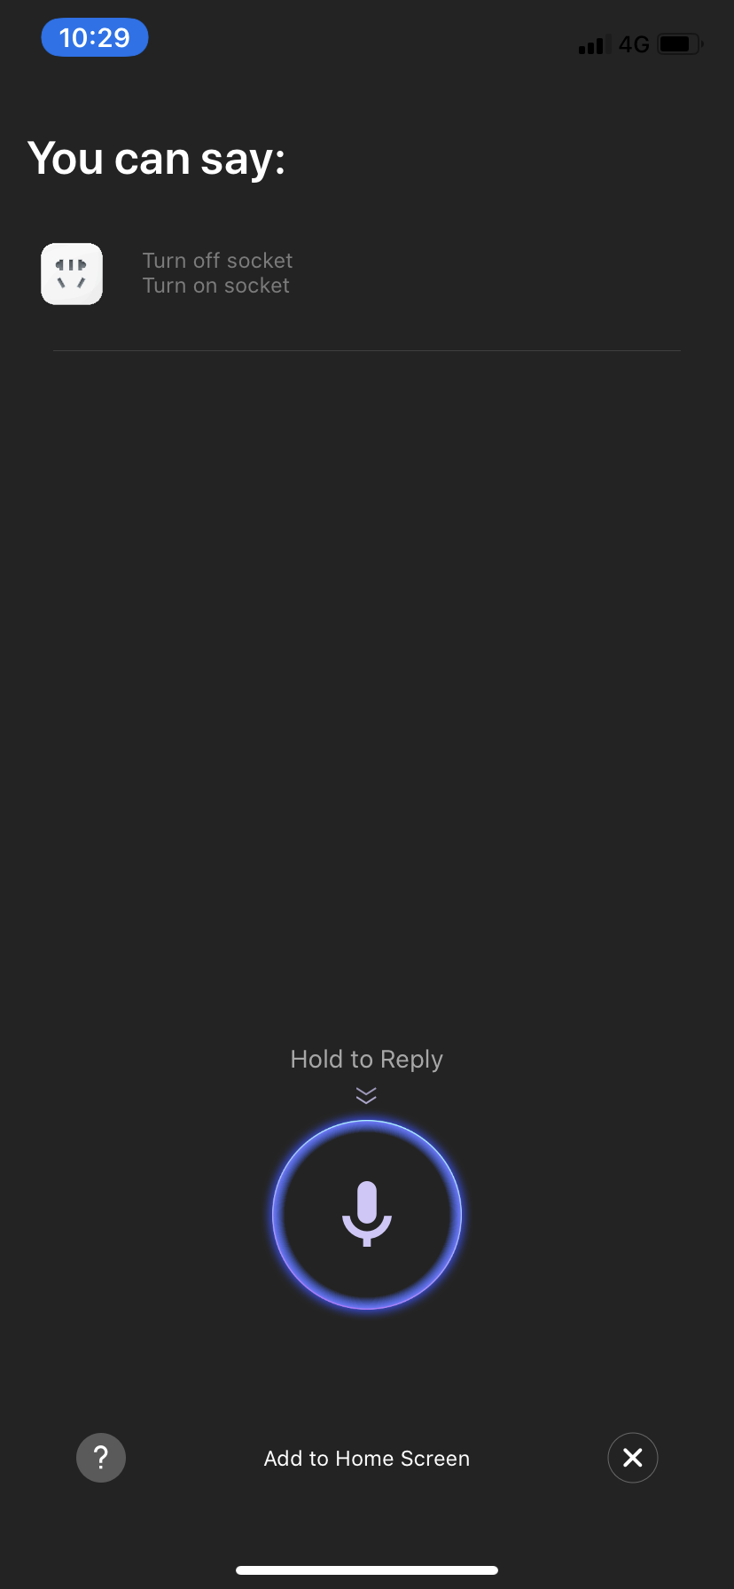
26
Voice control
28
Tuya APP support voice control directly
Through the button interface in the APP, click the microphone icon in the upper right corner, and the voice interface will appear.
The user can press the middle microphone button and directly say the name of the switch (such as turning on the "living room switch")
The corresponding switch will act accordingly.

Slide 34

















application

Slide 35






general user
Industrial users
Agricultural users
Home , school, municipal administration, property management, commercial premises, etc.
Factories, mining, base station towers, etc.
Agricultural irrigation, fish farming, etc.

Slide 36
THANKS
浙江省乐清市经济开发区纬三路192弄22号
No. 22, 192 Lane, Weisan Road, Yueqing Economic
Development Zone, Zhejiang , China
网址：www.wifimcb.com
邮箱：wdyk@wifimcb.com
电话：400-9057118

